Slide 1
Signs and Symptoms of Urinary Tract Disorders
Mohsen Amjadi M.D.
amjadizm@yahoo.com

Slide 2
اهداف
آشنائی کلی دانشجو با علائم و نشانه های شایع بیماریهای ارولوژی
  دانشجو بتواند ماهیت و علل شایع درد فلانک و سوپراپوبیک را توضیح دهد.
  دانشجو بتواند انواع هماچوری و علل شایع آن را نام ببرد.
  دانشجو بتواند علائم LUTS و علل شایع آن را توضیح دهد.
  دانشجو بتواند انواع بی اختیاری ادراری را توضیح دهد.
روش ارزیابی :
تئوری بیشتر بصورت MCQ
عملی بصورت استفاده از فرمهای Logbook

Slide 3
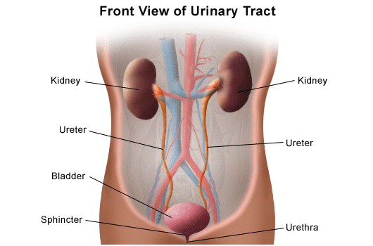

Slide 4
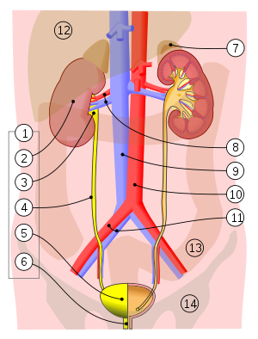

Slide 5
Symptoms of urinary tract disease
Pain in the costovertebral angle.
Hematuria :passage of blood in the urine.
Dysuria: pain associated with micturition.
LUTS.

Slide 6
Symptoms of urinary tract disease
Urinary Retention.
Urinary Incontinence.
Pneumaturia :passage of bowel gas in the urine
Hemospermia: passage of blood in the semen.

Slide 7
Pain
“Dull Pain”
Pain in the renal angle, the posterior space between the lowest rib and the iliac crest
Renal inflammation ,renal stones, tumors or polycystic disease may cause dull and persistent loin pain even without obstruction.
This area may also be tender to palpation or percussion.

Slide 8
Pain
In acute infections such as pyelonephritis or bladder infection, renal stone the pain is more severe and is usually associated with systemic features and disorders of micturition .

Slide 9
Pain
“Renal Colic”
Acute obstruction and distension of the pelvicalyceal system produces excruciating loin pain which often radiates to the groin ,scrotum or labium.

Slide 10
HAEMATURIA
Haematuria is divided as:
(1)gross haematuria
(2)microscopic haematuria

Slide 11
HAEMATURIA
More than 3 rbc/hp after centrifuge called microscopic bleeding,
and 1ml blood in 1000ml urine appears red color called gross hematuria.
Sometimes urine presents red color because of taking some drugs(Rifampicin)

Slide 12
HAEMATURIA
This red urines can be distinguished from haematuria by the absence of red blood cells on urinary microscopy.

Slide 13
CAUSES OF HAEMATURIA
Irritation from infections
Stone diseases
Trauma
Benign prostatic hypertrophy(BPH)
Tumors
Some anticoagulant therapy

Slide 14
DIAGNOSTIC FEATURES OF HAEMATURIA
Initial Hematuria is in the beginning of urination, means bleeding from urethra .
Terminal hematuria in the end means lesion arise from bladder triangle or bladder neck or posterior urethra.
Full-course hematuria means bleeding from bladder or beyond bladder.
Three-glass test .

Slide 15
DIAGNOSTIC FEATURES OF HAEMATURIA
Gross bleeding results in the passage of clots, the shape of which sometimes indicates their origin.
Clots that form in the ureter are long and stringy,
Clots formed within the bladder are more globular, irregular.

Slide 16
DIAGNOSTIC FEATURES OF HAEMATURIA
Urethral bleeding may leak out independently of micturition, or be seen only at the beginning or end of the urinary stream.
Urethrorrhagia

Slide 17
DISORDERS OF MICTURITION
“DYSURIA”
Feeling pain or discomfort on micturition, often having difficulty in voiding. The pain can be described as “burning” or “scalding”.

Slide 18
DYSURIA
Any irritation of the urethra may cause dysuria.
The most common cause is urinary tract infection, but urethral instrumentation, or the presence of a catheter, also commonly cause dysuria.

Slide 19
“Frequency”
Frequent passage of small quantities of urine.

Slide 20
Frequency
  Bladder irritation and infection is the most common cause of urinary frequency is usually accompanied by dysuria.
  The patient feels an almost constant need to pass urine regardless of the amount of urine in the bladder.
  prostatic hypertrophy(BPH)

Slide 21
Frequency
Small or indistensible bladder
This is a rare cause of frequency and may be due to surgical resection or inflammatory fibrosis such as tuberculosis or idiopathic interstitial fibrosis.

Slide 22
NOCTURIA
The need to pass urine at night.
The patient may wake with the urge to void hourly.
normally,adults arise no more than twice at night to void

Slide 23
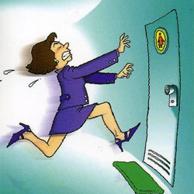
Urgency
The sudden desire to void

Slide 24
URGENCY
The sudden desire to void, which if ignored, may result in incontinence.
Bladder neck irritation or abnormal entry of urine into the proximal urethra would result in urgency.

Slide 25
HESITANCY
Difficulty in initiating micturition, known as hesitancy.
The usual cause is prostatic obstruction, which prevents entry of sufficient urine into the proximal urethra to initiate sphincter relaxation.

Slide 26
POOR URINARY STREAM
When there is a urethral obstruction, such as BPH and urethral stricture, the urinary stream is reduced.

Slide 27
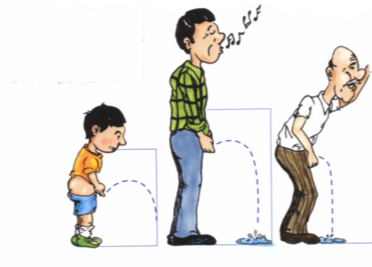
DISORDERS OF MICTURITION

Slide 28
POST-MICTURITION DRIBBLING
Urine flow does not cease completely at the end of micturition.
This condition may result from abnormal sphincter function, voiding incompletely.

Slide 29
RETENTION OF URINE
Inability to void when the bladder is full due to the sphincter unable to relax or a proximal urethral obstruction.
Acute retention---most commonly seen in postoperative patients.
Other common cause are BPH, obstruction of blood clot or stones.

Slide 30
RETENTION OF URINE
Chronic retention---abnormalities of structure or function of the bladder muscle or sphincter mechanism, or persistent urethral obstruction.

Slide 31
RETENTION OF URINE
In chronic retention, voiding of urine is often incomplete.
The bladder tend to be over distended.
Bladder may show muscle hypertrophy, diverticula.
Gradually the residual volume approaches maximum bladder capacity.

Slide 32
URINARY INCONTINENCE
Stress Incontinence
Urge Incontinence
Overflow Incontinence
True Incontinence

Slide 33
URINARY INCONTINENCE
“Stress incontinence”
Any sudden increase of pressure on the bladder ( coughing, sneezing or laughing) causes small quantities of urine to leak out.
Women with many children damage the pelvic floor during childbirth, post-TURP, contracted and small-volume bladder, et al.

Slide 34
URINARY INCONTINENCE
“Urgency incontinence”
detrusor activity becomes hypersensitive so that the voiding reflex is initiated when the bladder volume is well below full capacity.(cyctitis,neurogenic bladder)

Slide 35
URINARY INCONTINENCE
“Overflow Urinary Incontinence”
overflow urinary incontinence is secondary
to advanced urinary retention and high residual urine volumes,
Bladder is chronically distended, and never empties completely.
Urine may dribble out in small amounts as the bladder overflows.

Slide 36
URINARY INCONTINENCE
“True Incontinence”
Refers to the involuntary loss of urine at all times and in all positions.
Continuous incontinence is most commonly caused by damaging of the urethral sphincter , Neuropathic bladder dysfunction as result of diabetes strokes , Parkinson’s disease.

Slide 37
Hematospermia
Refers to the presence of blood in the seminal fluid ,
Most commonly results from nonspecific inflammation of the urethra,prostate,and/or seminal vesicles

Slide 38
Physical examination
hypertension may be a feature of pyelonephritis, renal artery stenosis, polycystic kidneys, et al.

Slide 39
Abdominal examination
Huge renal mass can be seen: Wilm’s tumors, polycystic kidney.
A lopsided bladder in chronic retention.
A bimanual techniques: to palpate kidney diseases.
Lower abdomen palpation for bladder mass.

Slide 40
Rectal examination
In the male, the prostate is palpated for size, shape, and consistency.
On palpation, the normal prostate has a smooth surface and a firm consistency, and is divided into two lateral lobes by a midline groove.
Prostatic carcinoma: irregular, hard nodules

Slide 41
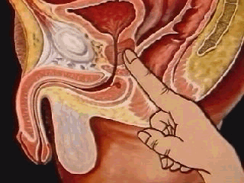
Rectal examination

Slide 42
Are any blood tests likely to be helpful in diagnosis
PSA for Pca.

Slide 43
Ultrasonography
Valuable non-invasive technique for investigating a suspected renal mass, differentiatng solid from cystic lesions, and demonstrating dilatation of the renal pelvis.

