Slide 1
NEUROGENIC BLADDER
S Hajebrahimi MD
Professor of Urology Department
TUMS

Slide 2
اهداف :
  آشنایی با تعریف و اتیولوژی علایم ادراری تحتانی
  آشنایی با روشهای تشخیصی
  آشنایی با روشهای درمانی
روش ارزیابی :
تئوری بیشتر بصورت MCQ
عملی بصورت استفاده از فرمهای Logbook

Slide 3


Slide 4
Neurogenic Bladder
A urinary tract dysfunction
Condition may be congenital or acquired
No cure but can be managed
Most cases managed with medication and intermittent catheterization
The primary goal of the Urologist is to maintain and preserve renal function!

Slide 5
Neurogenic Bladder
Spina Bifida
Multiple Sclerosis
Parkinson Disease
Cauda equina syndrome
Paralytic syndrome
Stroke complications
Brain injury

Slide 6
Neurogenic bladder
Spinal cord injury
Diabetes mellitus
Heavy metal poisoning
Acute infections
Spinal cord tumors
Syphilis
Benign prostatic hyperplasia

Slide 7
Neurogenic Bladder
Sensory – posterior columns of the spinal cord or afferent tracts leading from the bladder.
Motor paralytic bladder – damage to motor neurons.
Uninhibited – incomplete lesion above S2.
Reflex - complete lesion above S2.
Autonomous - cauda equnia lesions.

Slide 8
Neurogenic Bladder
Bladder functions will change.
Goals and priority will change.
Risks for interventions will change.

Slide 9
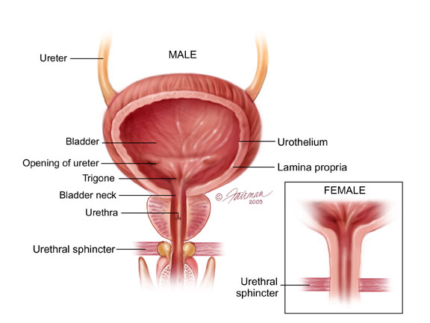

Slide 10
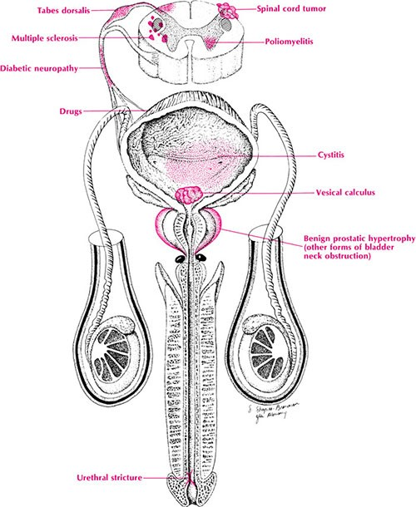

Slide 11
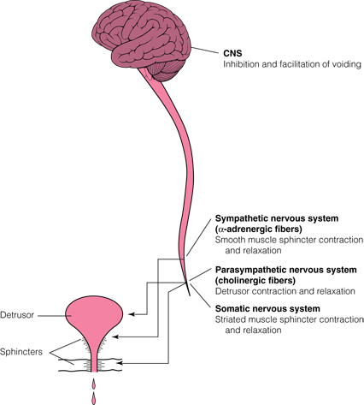

Slide 12
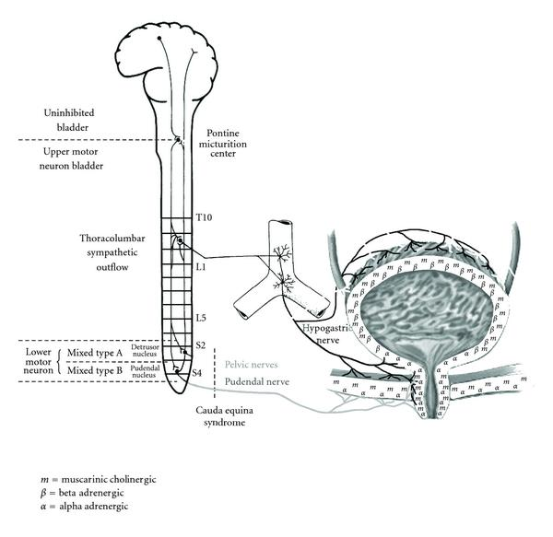

Slide 13
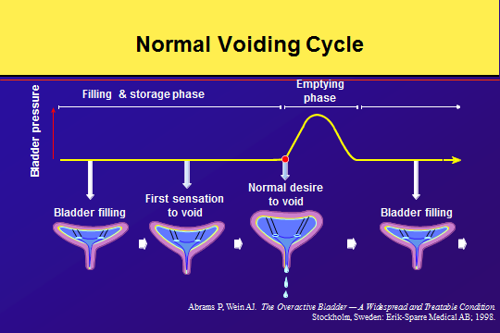

Slide 14
Neurogenic Bladder
Underactive– damage to the spinal cord due to spinal cord lesions. These bladders are distended with overflow.
Overactive– caused by brain or upper spinal cord damage that result in paraplegia or quadriplegia. These bladders do not distend and leak.

Slide 15
Neurogenic Bladder
Symptoms:
  UTI
  Stone disease
  Incontinence
  Fever
  Chills
  Hematuria
  Kidney injury

Slide 16
Neurogenic Bladder
Clinical presentations
  Frequency
  Nocturia
  Incontinence - urge, over flow
  UTI
  Retention

Slide 17
Neurogenic Bladder
Hyperreflexic--------------------Neurogenic DO
Hyporeflexic --------------------Impaired contractility
Areflexic

Slide 18
Neurogenic Bladder
Complications:
  Sepsis
  Hydronephrosis
  Renal failure

Slide 19
Neurogenic Bladder
Evaluation:
  S&S with UTI hx.
  Urgency and the relationship to incontinence
  S&S of obstruction
  Voiding diary
  Awareness of full bladder
  Fecal incontinence
  Erection
  GYN hx.

Slide 20
Neurogenic Bladder
Exam:
  Neurologic
    Sphincter tone
    Bulbocavernosus reflex
    Anal reflexes
    Exam vaginal wall at rest and with valsalva
    Vaginitis
    Proplase
    Levator tone

Slide 21
Neurogenic Bladder
Tests:
  PVR
  Labs – cbc, bmp, ua, c&s
  Urodynamic
  CT or IVP
  US
  Cystoscopy
  RUG

Slide 22
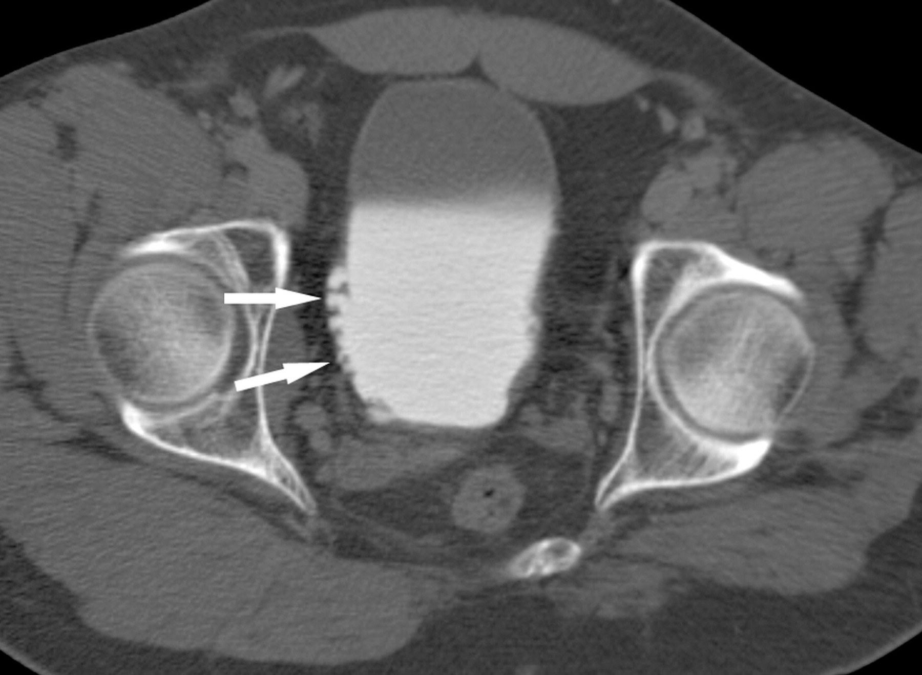
Figure 12. Neurogenic bladder and multiple diverticula in a 25-year-old man.

Slide 23
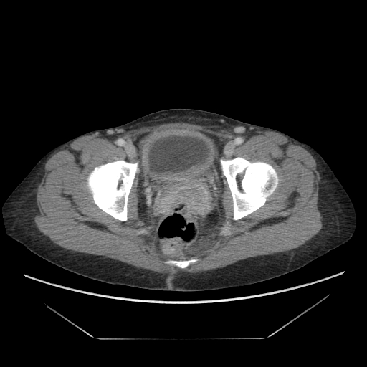
Notes:
CT images of Bladder Wall Thickening

Slide 24
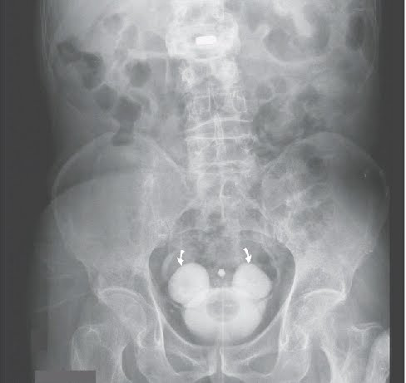
Notes:
Bilateral Bladder Diverticulia

Slide 25
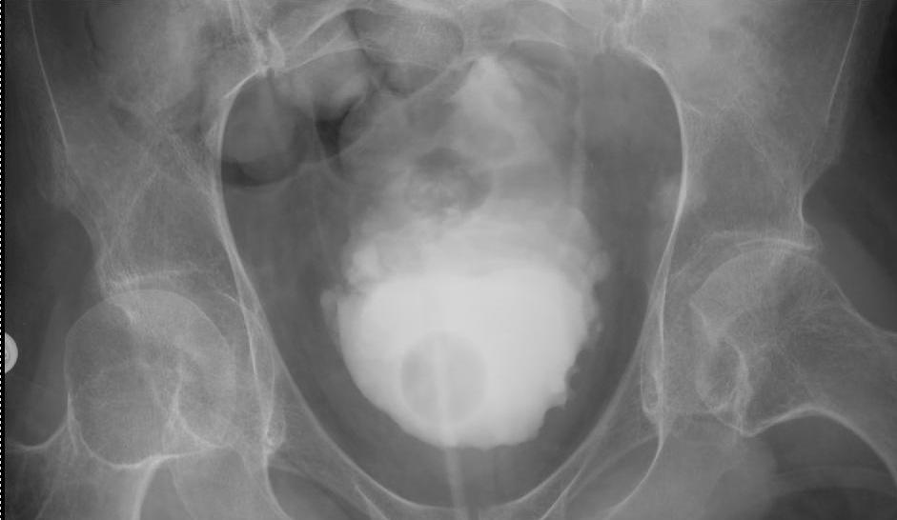
Notes:
This is a paraplegia from a spinal cord injury at T1 level. This image taken from an IVP series shows contrast filling the bladder which has indwelling catheter in it. The elongated and pointed configuration of the bladder is the classic “pine-cone” or “Christmas tree” appearance of a severe neurogenic bladder.

Slide 26
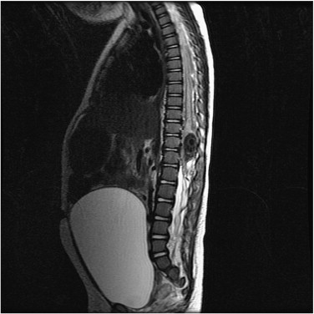

Slide 27
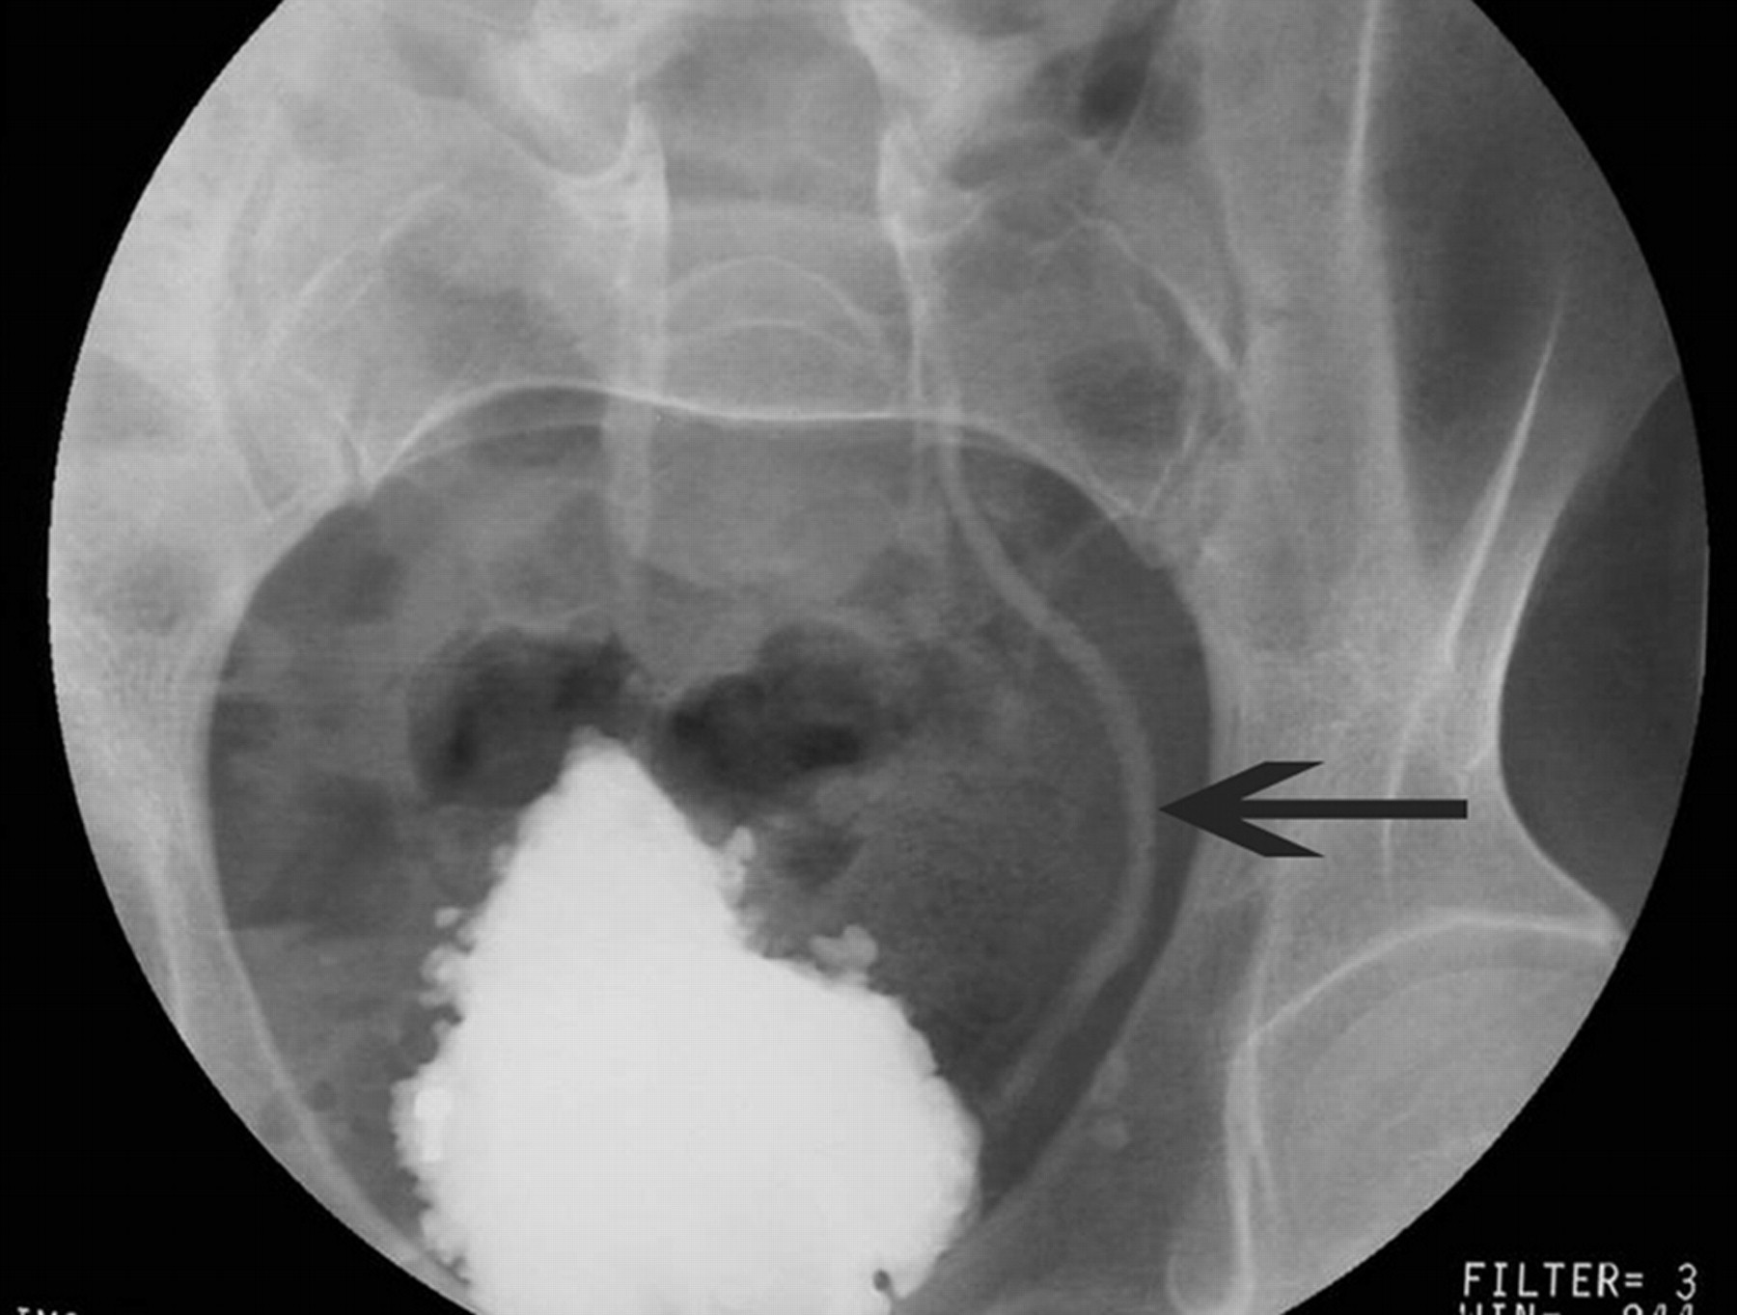
Notes:
Micturating cystourethrogram in an adult patient with known spina bifida and deteriorating renal function. The bladder is irregular, in keeping with a neurogenic bladder. There is free reflux seen in the left ureter(arrow).

Slide 28
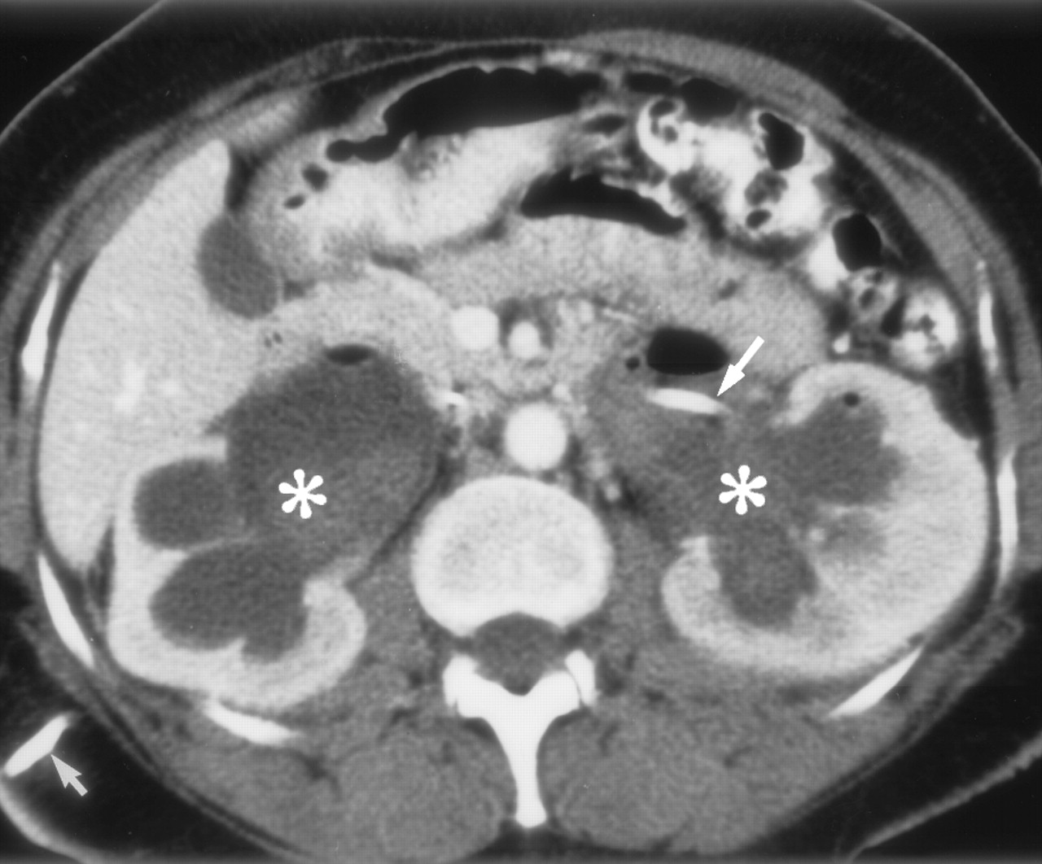
Notes:
CT of bilateral hydronephrosis

Slide 29
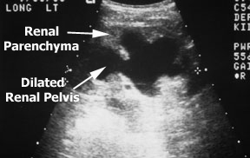

Slide 30
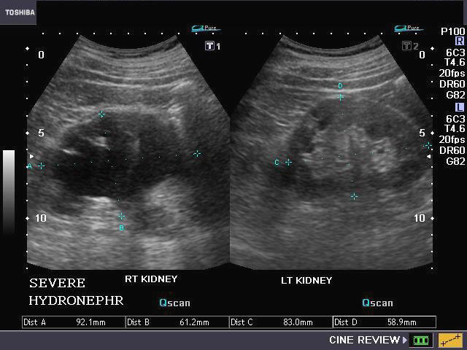

Slide 31
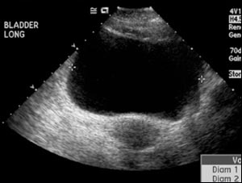

Slide 32
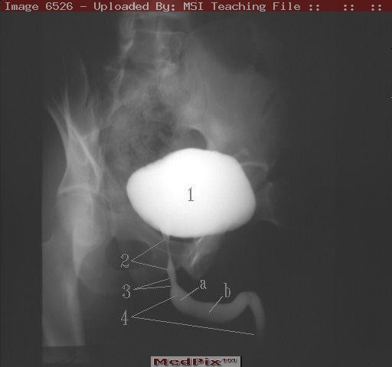

Slide 33
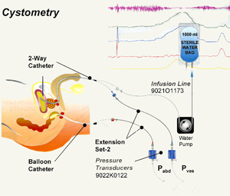

Slide 34
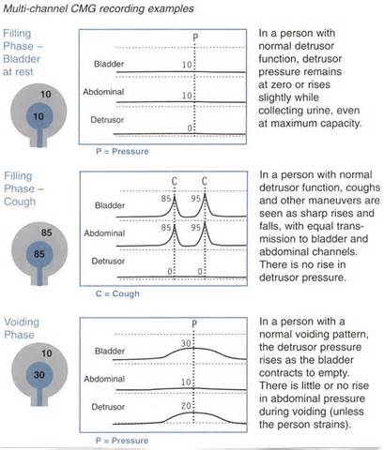

Slide 35
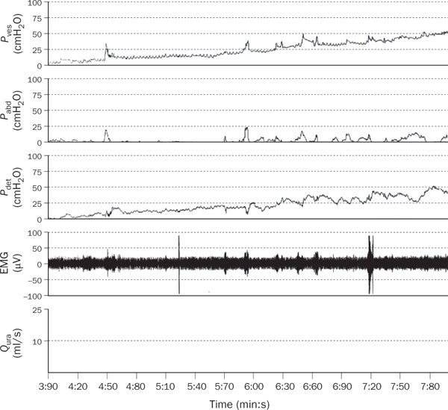

Slide 36
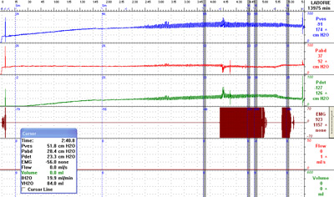
Notes:
Neurogenic Bladder

Slide 37
Neurogenic Bladder
Treatments:
  Anticholinergics
  Alpha-adrenergic stimulation
  Intermittent self-catheterization
  Surgical treatments
  Pelvic floor re-hab
  Bladder training
  Electrical stimulation
  Botox injections

Slide 38
Neurogenic Bladder
            AGAIN:
Bladder function changes throughout the life span
Goals and priorities are ever changing
Risks for interventions change throughout the life span

Slide 39
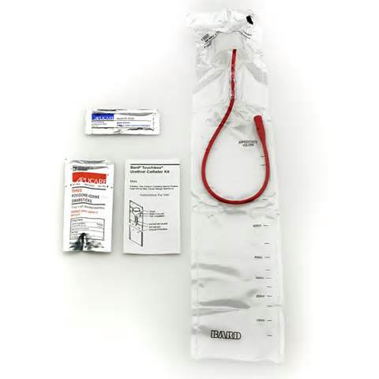

Slide 40
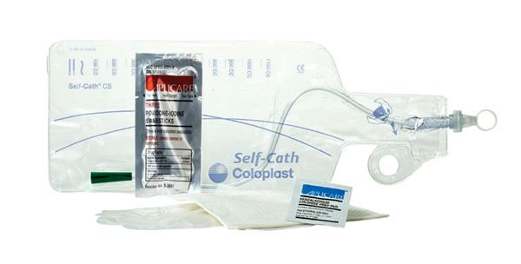

Slide 41
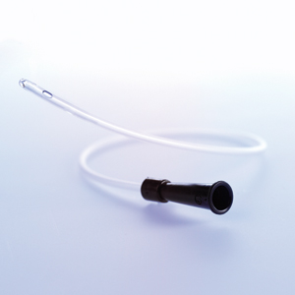

Slide 42
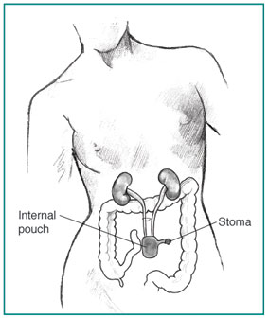
Notes:
Urostomy and Continent Urinary Diversion

Slide 43
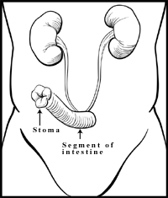
Notes:
Ileal Conduit Urinary Diversion: A segment of the intestine directs urine through a stoma into an external collecting bag.

Slide 44
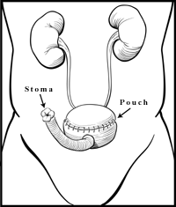
Notes:
Indiana Pouch Reservoir: A pouch made out of portions of intestines stores urine until it is drained via a catheter inserted through the stoma.

Slide 45
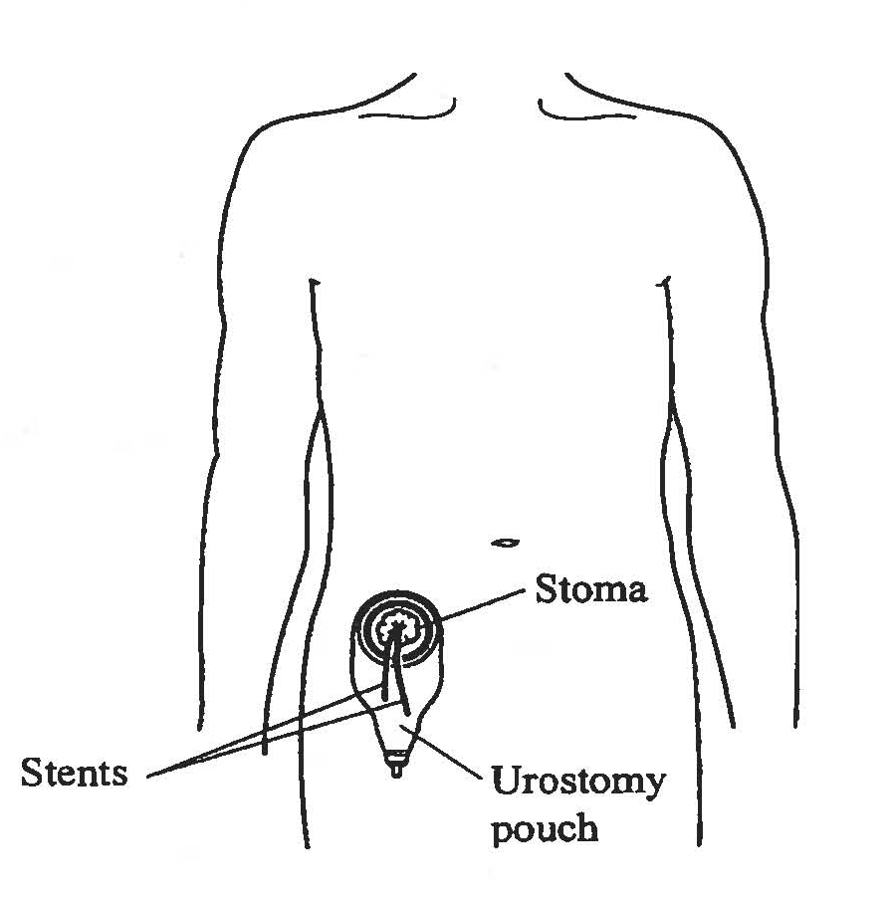
Notes:
Radical Cystectomy with Ileal Conduit Urinary Diversion

Slide 46


Slide 47
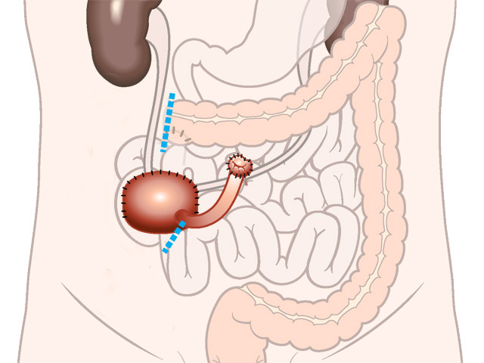

Slide 48
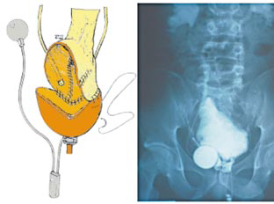
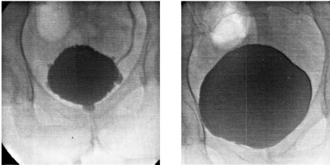
Notes:
Bladder augmentation, AUS

Slide 49
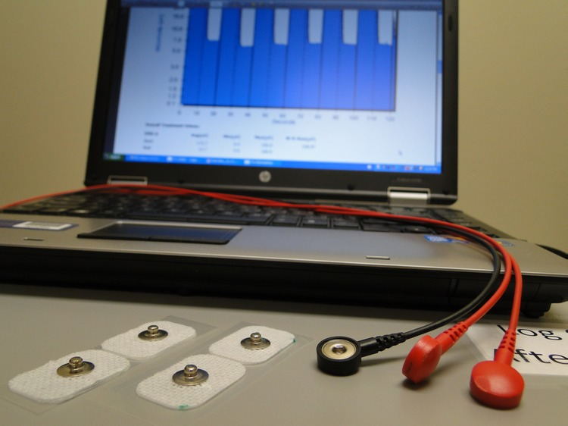

Slide 50
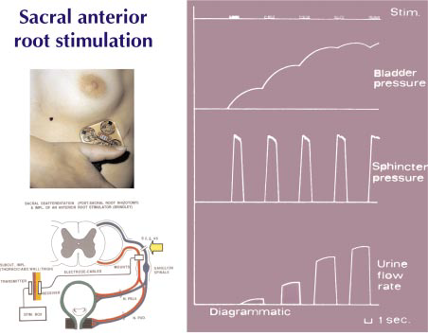

Slide 51
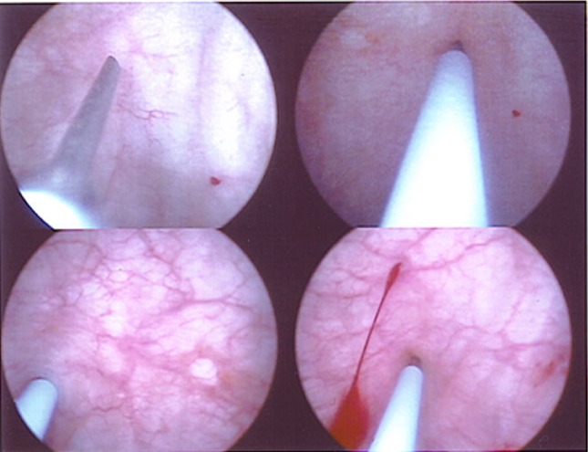
Notes:
Botox Injections

Slide 52
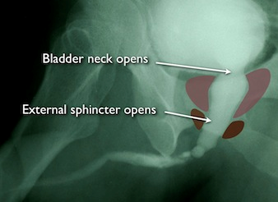
Notes:
Voiding

Slide 53
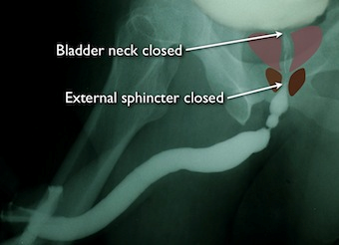

Slide 54
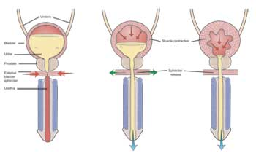

Slide 55
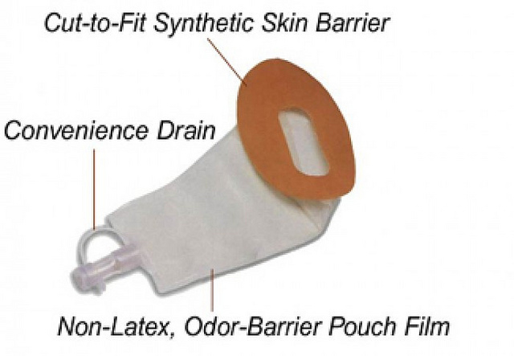

Slide 56
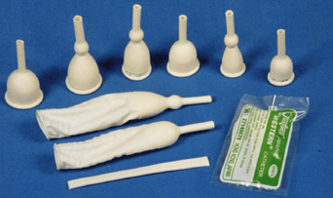

Slide 57
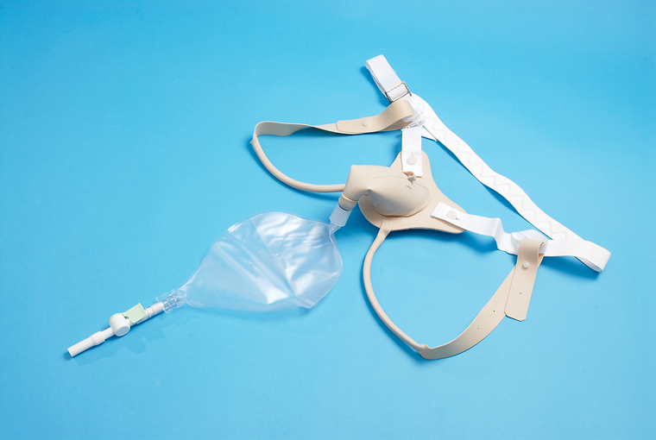

Slide 58
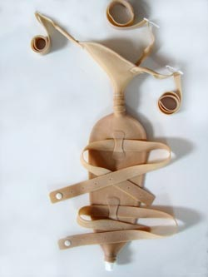

Slide 59
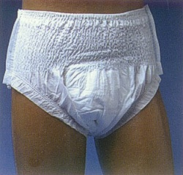

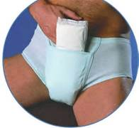
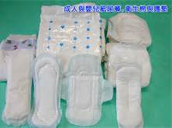
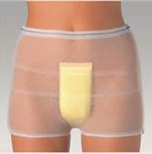
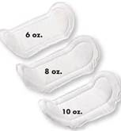
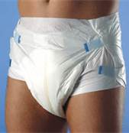



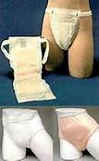
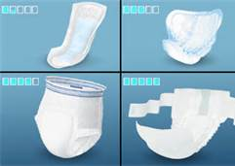

Slide 60
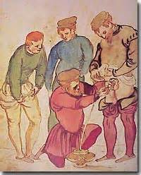
THANK YOU

